Slide 1
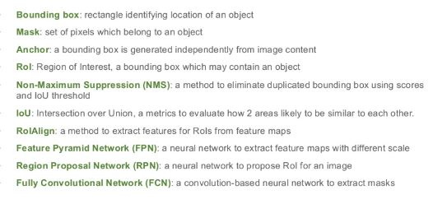
Terminologies

Slide 2
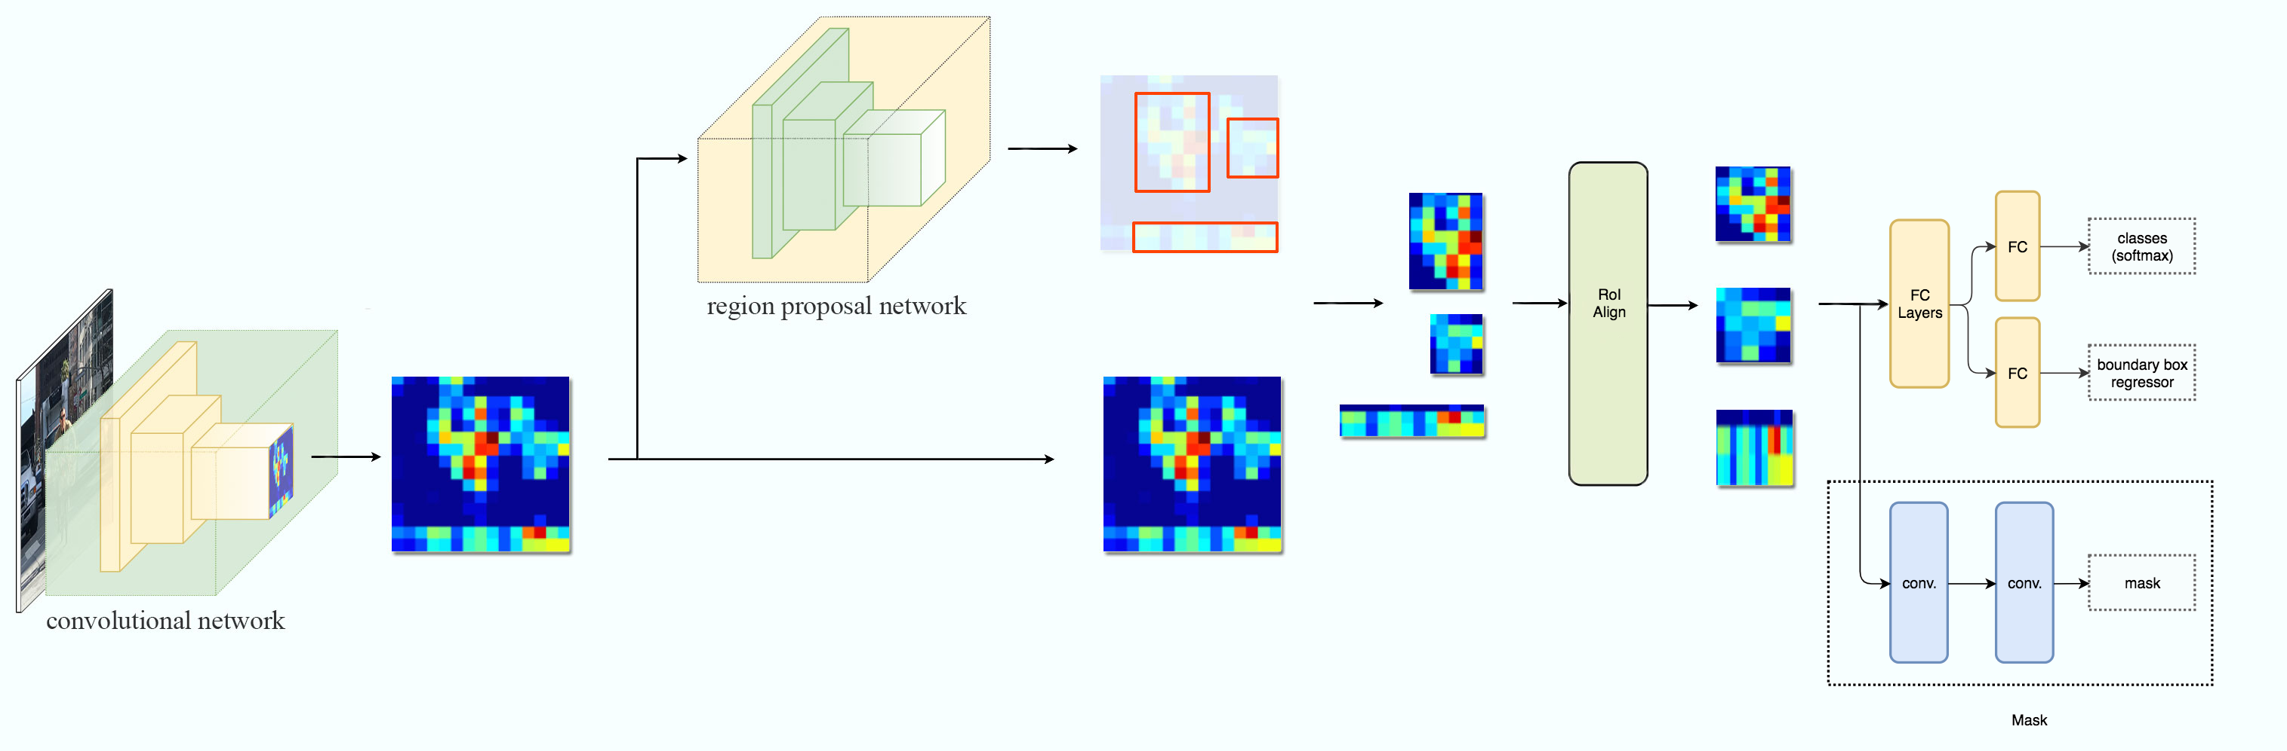
Mask R-CNN Architecture

Slide 3
Mask R-CNN Architecture
Backbone

Slide 4
Mask R-CNN Architecture
Backbone
Feature map

Slide 5
Mask R-CNN Architecture
Anchor Boxes with different ratios
Backbone
Feature map

Slide 6
Mask R-CNN Architecture
Anchor Boxes with different ratios
Backbone
Selected Regions
Feature map

Slide 7
Mask R-CNN Architecture
Anchor Boxes with different ratios
Backbone
Selected Regions
Feature map
Fixed size Regions

Slide 8
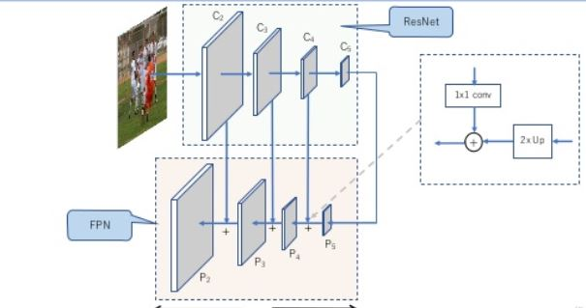
Backbone

Slide 9
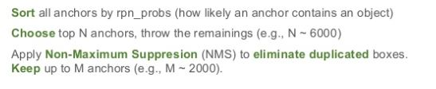
Proposal Layer

Slide 10
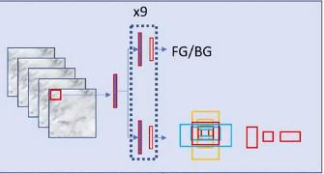
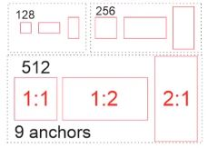
Reducing Proposals
If feature maps sizes are 50 * 60 then 50 *60 *9= 27,000 possible anchors. Now how to handle that large number of anchors?
Softmax

Slide 11
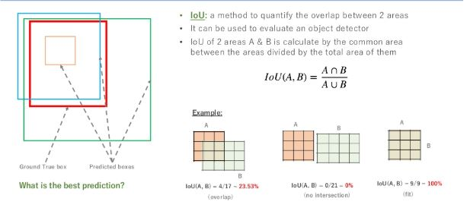
IOU-Intersection over Union

Slide 12
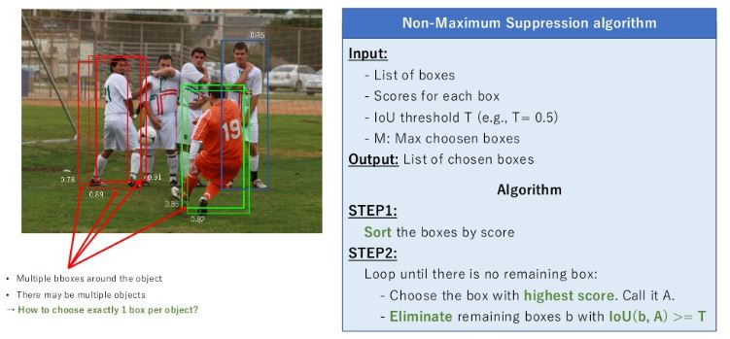
NMS -Non Maximum Suppression

Slide 13
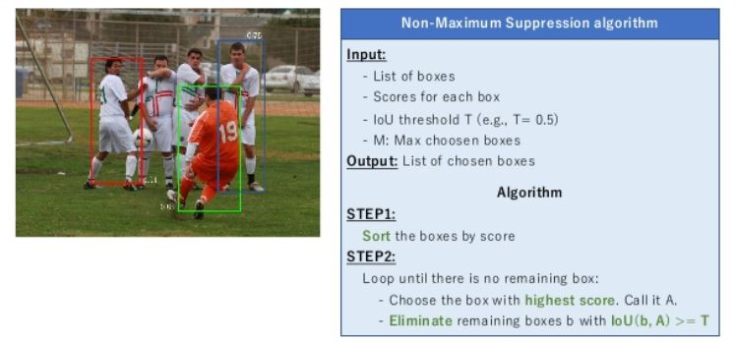
NMS -Non Maximum Suppression

Slide 14
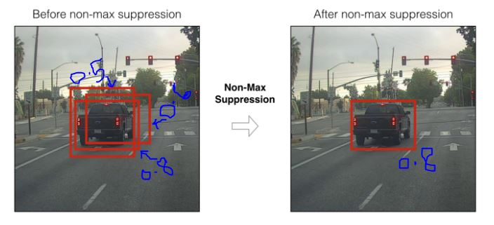
NMS -Non Maximum Suppression

Slide 15
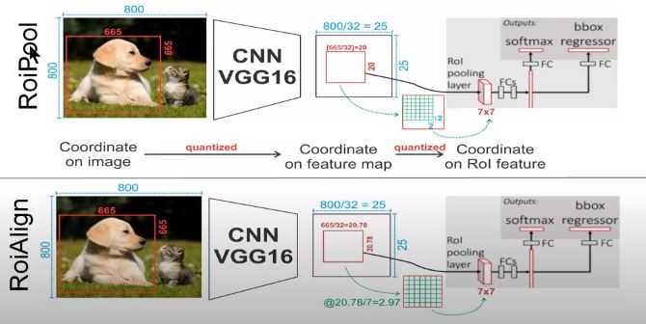
RoiPool vs RoiAlign

Slide 16
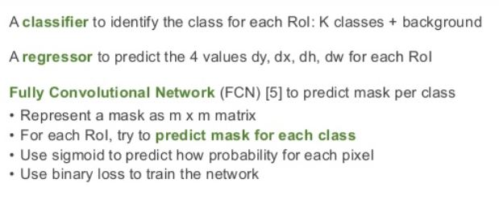
Mask R-CNN head network

Slide 17
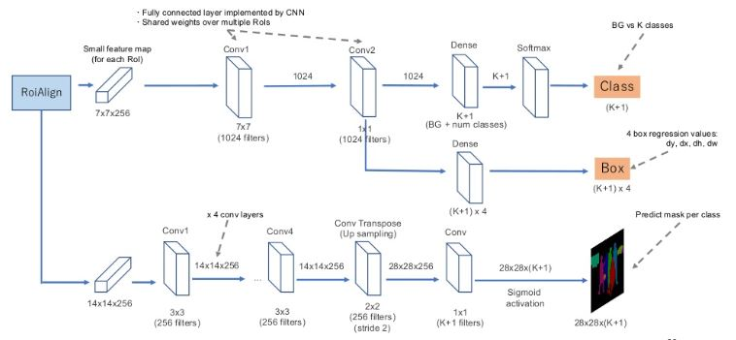
Mask R-CNN head network

Slide 18
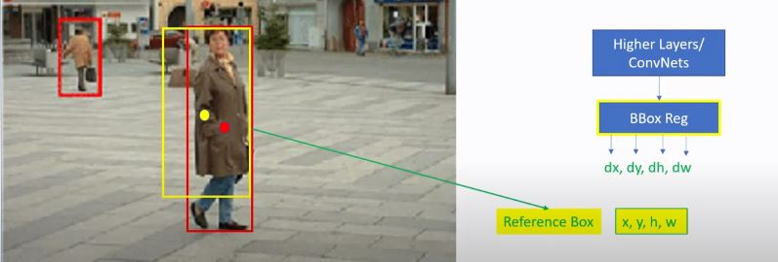
Relative Bounding-BOX Regression

Slide 19
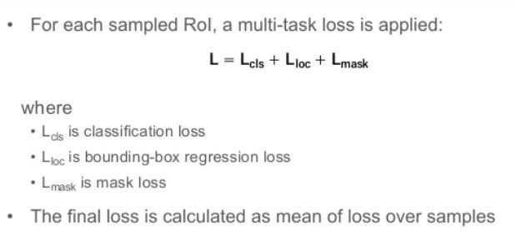
Loss Function

Slide 20
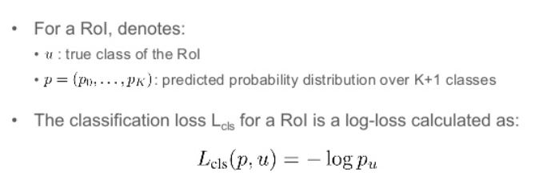
Loss for Lcls

Slide 21
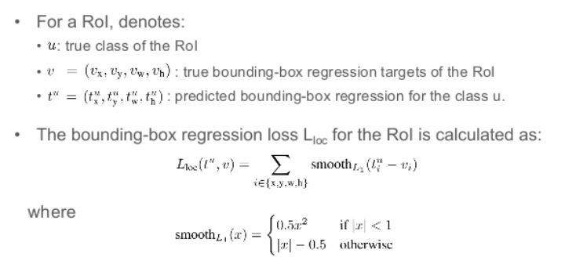
Loss for Lloc

Slide 22
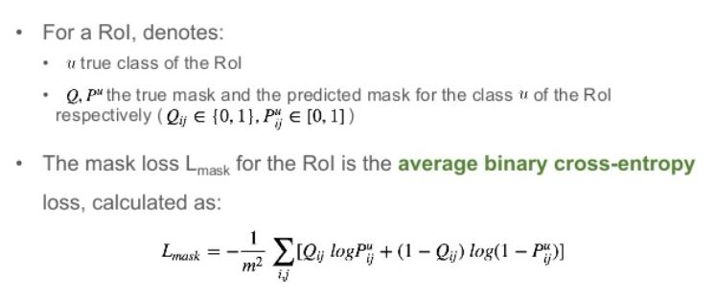
Loss for Lmask

Slide 23
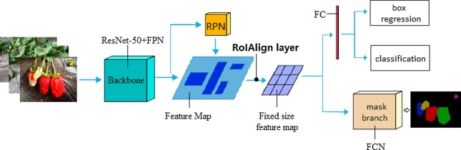
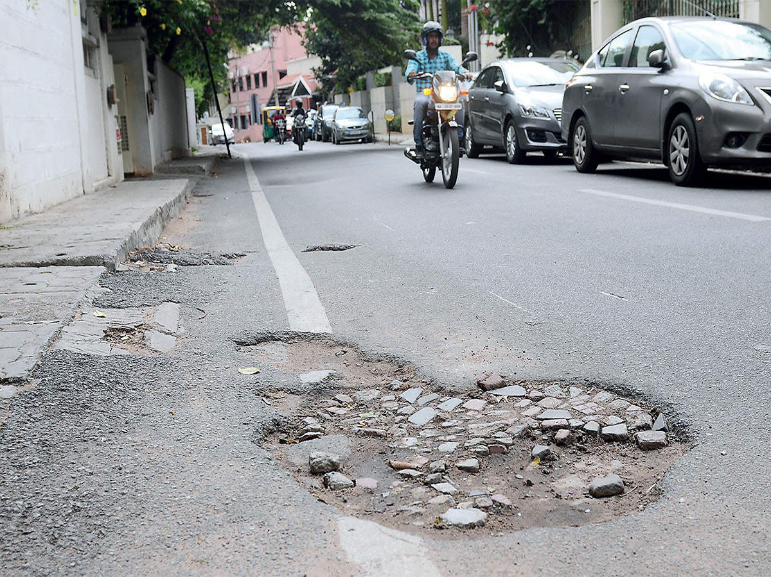
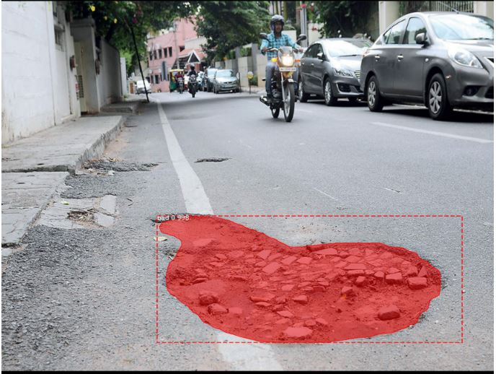
At a glance
Output
Input

Slide 24
References
https://www.slideshare.net/hitheone/maskrcnn-for-instance-segmentation-117485267
https://towardsdatascience.com/non-maximum-suppression-nms-93ce178e177c
https://everitt257.github.io/blog/2019/02/07/RoI-Explained.html#:~:text=ROI%20Align,example%20(18.4%2C%20240.8).

